Slide 1
Ansible collection
ow

Slide 2
overview
An Ansible Collection is a structured package of Ansible content, including modules, plugins, roles, and playbooks. Collections help organize and distribute Ansible content for better reusability and modularity.
They enable users to group related automation content into a single shareable unit.
We can create our own customize collection or can use the one which is predefined.
Lot of modules are by default not available by-default, we need to use collection for the same

Slide 3
Key directory
docs/
Contains documentation files such as README.md.
Helps users understand the collection and how to use it.
files/
Stores files that roles or playbooks might need, like configuration files or binaries.
plugins/
Contains custom plugins for Ansible. These are grouped by type:
action/: Custom action plugins.
connection/: Custom connection plugins for new communication methods.
filter/: Jinja2 filter plugins.

Slide 4
..
roles/
Contains reusable Ansible roles. Each role has its own directory and substructure (e.g., tasks, vars, templates, etc.).
playbooks/
Stores playbooks that use the collection's roles, modules, or plugins.
galaxy.yml
Metadata file required for publishing the collection to Ansible Galaxy.
Defines attributes like the collection's name, version, author, and dependencies.

Slide 5
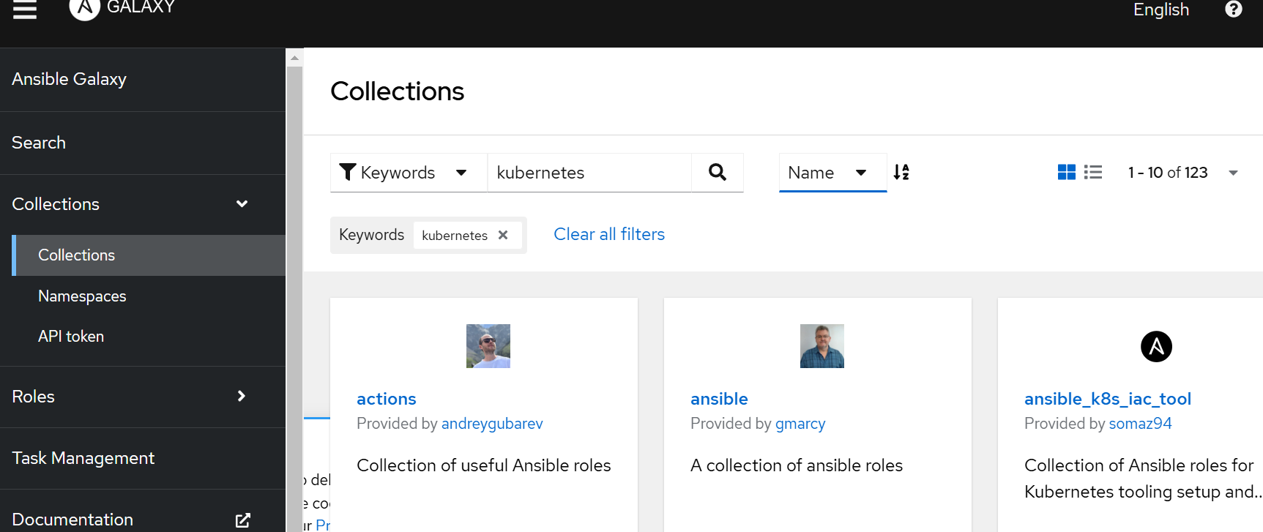
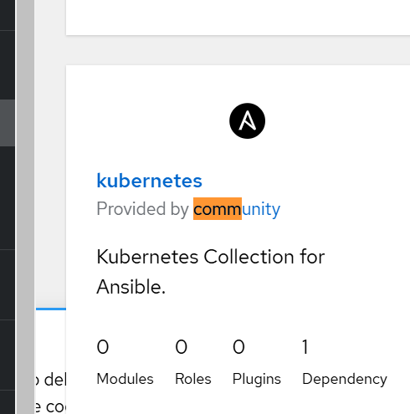
..

Slide 6
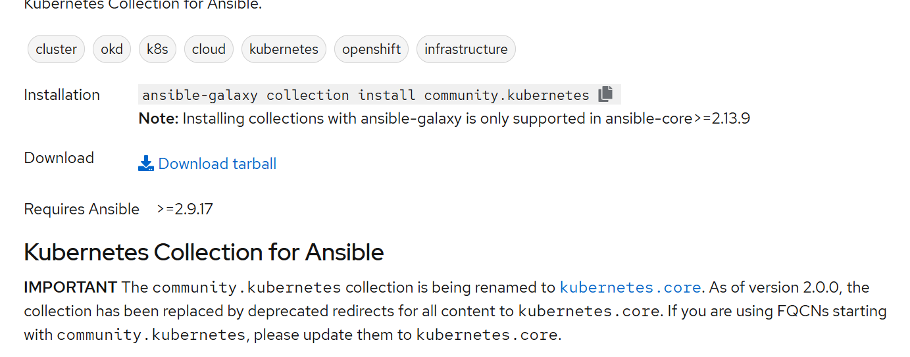
..

Slide 7



